Slide 1
Delivered Since Last Update
HET Level 1 software to produce CDF’s has been integrated into our processing stream and are currently being validated by our Co-I’s before final release.
A new release of the LET Level 1 software for the changed sectored data products has been integrated and is awaiting validation by Co-I’s.
CDAW is now serving IMPACT data thru Oct 31 2010 for most products
UCB now hosts a real-time browse page integrating selected SOHO and SDO ’latest’ images with solar wind and SEP data plots from STEREO and ACE (updated at NOAA SWPC)
Notes:
1

Slide 2
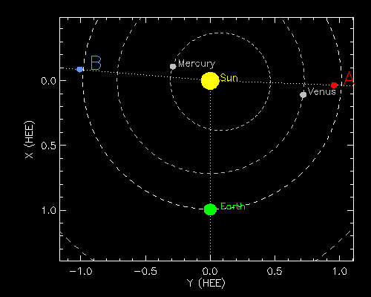
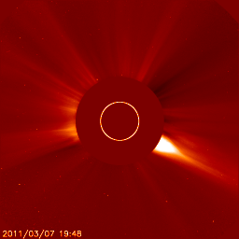

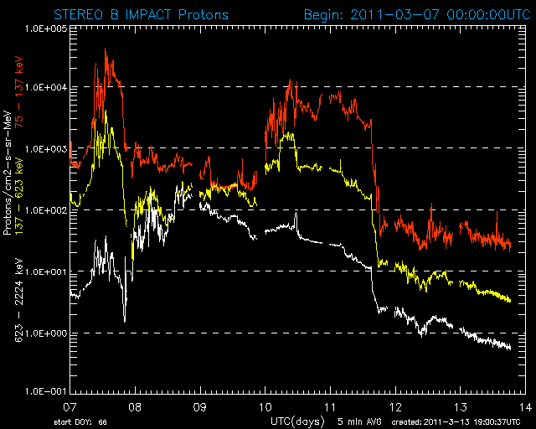
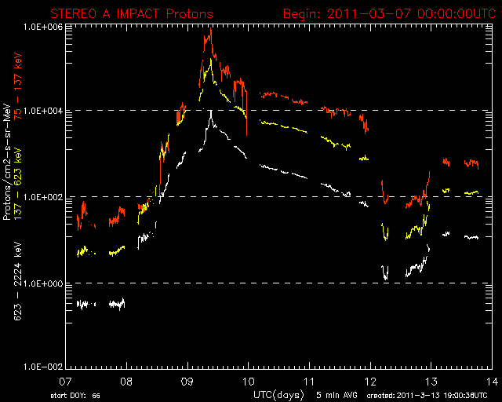
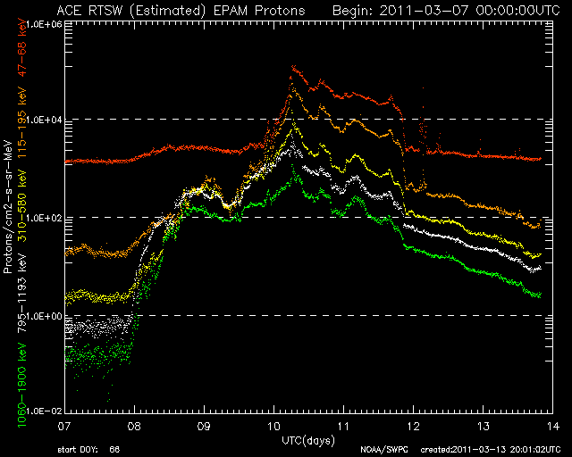
now available: STEREO (and ACE) real-time multipoint perspectives at 1 AU
Caption:
Real-time multipoint SEP
Events, early March. 2011
Data plots from NOAA SWPC
SOHO/LASCO, SDO/AIA images
http://stereo.ssl.berkeley.edu/multistatus.php

