Slide 1
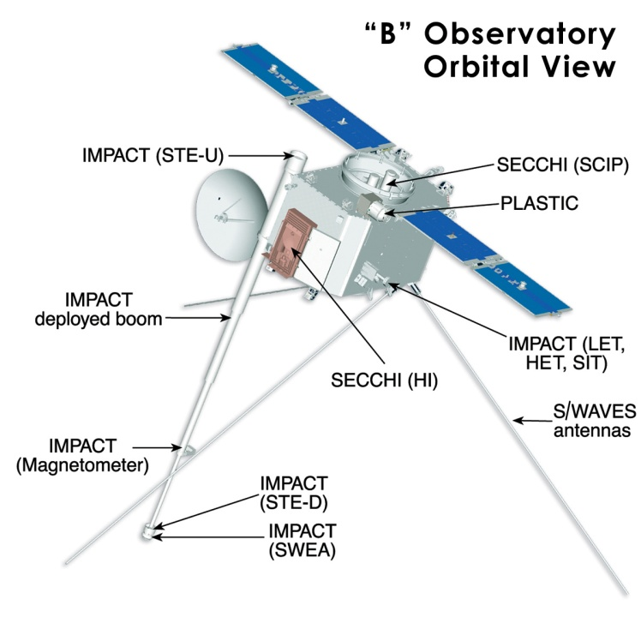
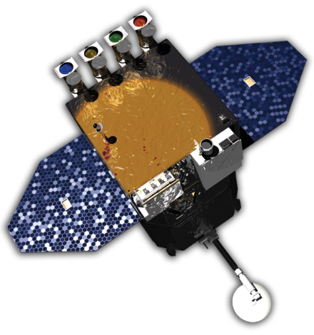
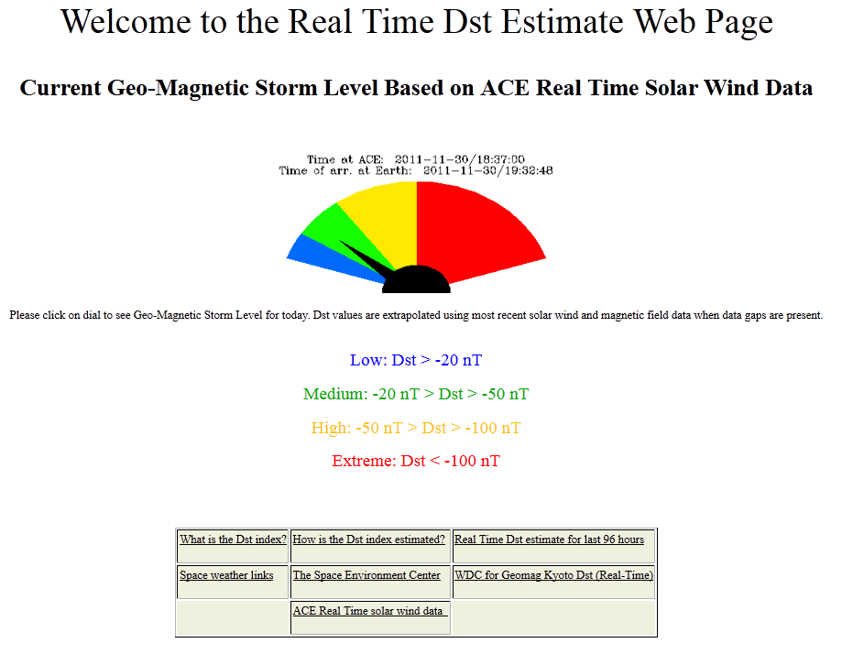
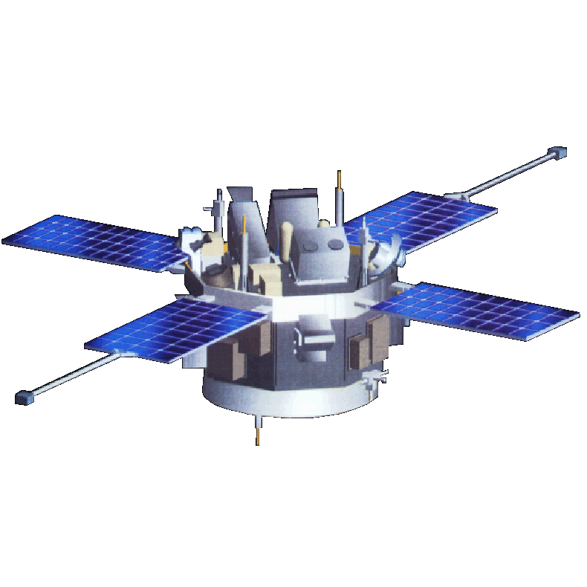
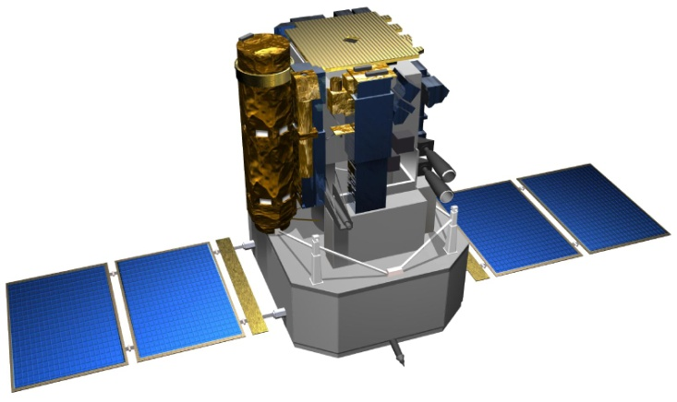
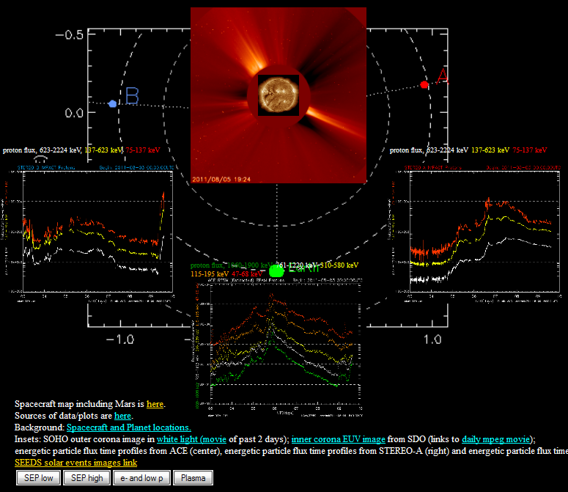
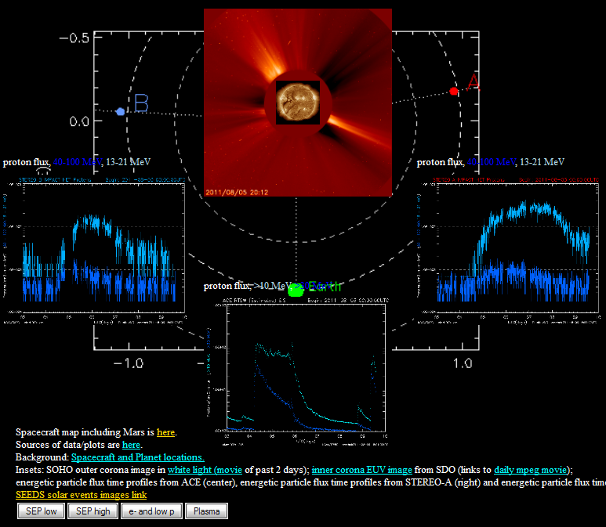
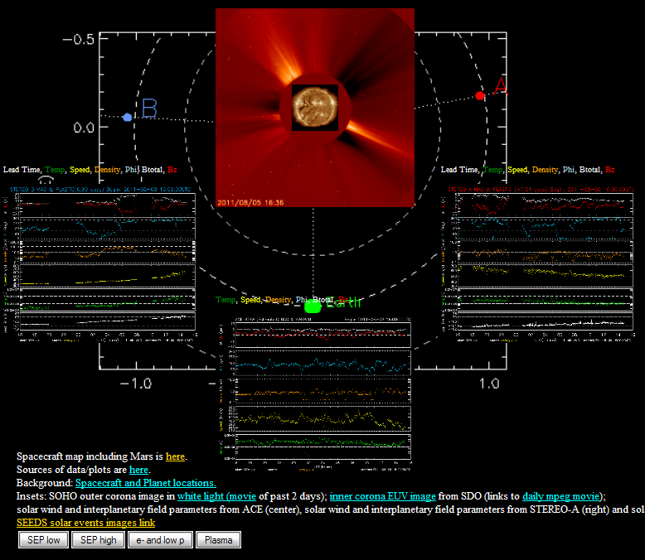
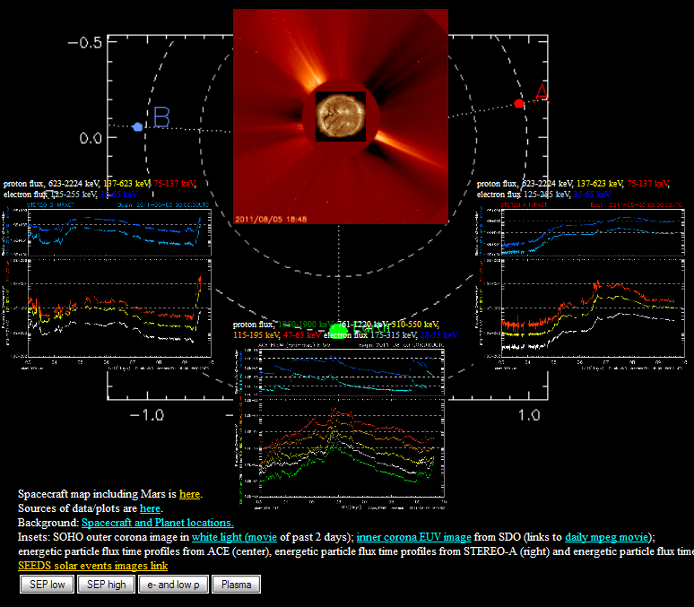
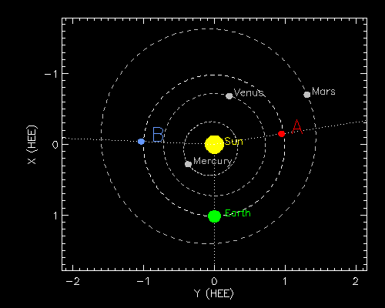
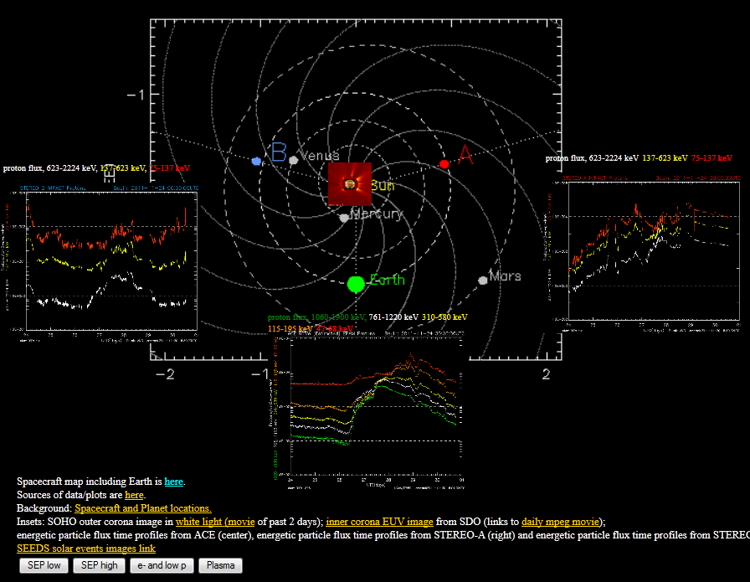
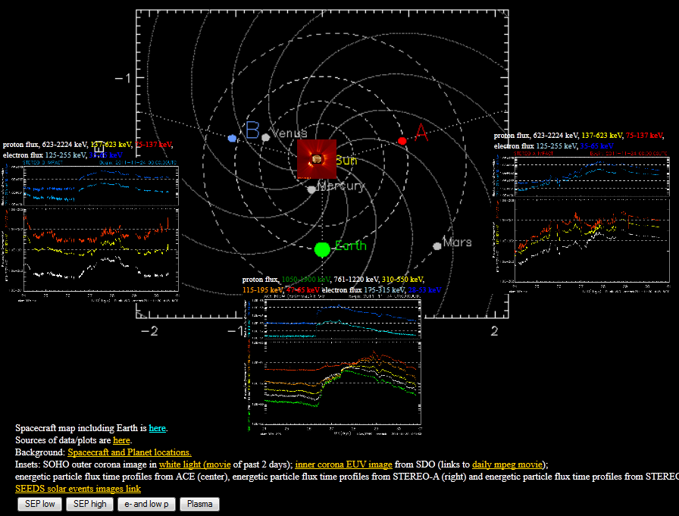
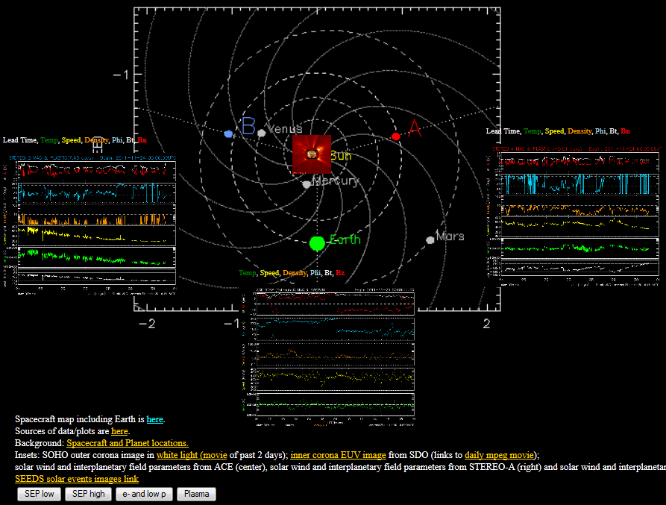
SH13A-1930
Real-Time Visualization Display Integrating STEREO, ACE, SOHO and SDO
P. Schroeder, J.G. Luhmann, and W. Marchant (University of California – Berkeley)
With Special Thanks to the STEREO/IMPACT, STEREO/PLASTIC, ACE/MAG, ACE/EPAM, ACE/SWEPAM, SOHO/LASCO, SDO/AIA, NOAA SWPC and STEREO SSC Teams for their Data and Plots
Integration of the Heliospheric Missions Gives a More Complete Understanding of Space Weather
DST Estimator
http://sprg.ssl.berkeley.edu/dst_index/
STEREO
SDO
The STEREO spacecraft provide a unique opportunity when combined with the near-Earth perspective. We are able to get a more complete picture of the inner heliosphere than ever before.
UC Berkeley has developed a real-time space weather web site utilizing real-time data from STEREO, ACE, SOHO and SDO.
Particle data and visualizations (movies and images) are combined in an intuitive way to give an overview of current solar activity.
Links to data and other real-time sites allows the user to investigate further, quickly and easily.
Four different real-time pages are provided allowing for coverage across the particle energy spectrum from solar wind plasma to SEP energies.
Alternative views emphasizing planetary science are also available.
A real-time DST estimate provides another quick-look way of seeing what is happening. DST proxies at the two STEREO spacecraft are also being developed.
ACE
SOHO
Our DST estimate page provides a quick way to assess current solar activity’s impact at Earth using real-time data from the ACE spacecraft. We are also developing DST proxies at the STEREO spacecraft locations.
The New Real-Time Display
http://stereo.ssl.berkeley.edu/multistatus.php
Current STEREO spacecraft separation now allowing for the full 360 degree view of the Sun when combined with near-Earth missions like SOHO.
Datasets displayed on the Berkeley Real-Time Site
STEREO/IMPACT MAG
STEREO/IMPACT HET
STEREO/IMPACT SEPT
STEREO/PLASTIC
ACE/MAG
ACE/EPAM
ACE/SWEPAM
(STEREO and ACE plots provided by the NOAA Space Weather Prediction Center)
SOHO LASCO C2
SDO AIA
STEREO spacecraft positions provided by the STEREO Science Center
Some examples of Berkeley’s real-time web site in action. The top row images are examples of our original view primarily focused on the Sun-Earth, Sun-STEREO connection. The bottom row images are examples of our new planetary connections display. We hope these will be useful for understanding what may be seen by planetary missions.
The SOHO LASCO C2 images are actually animated movies.
For more information, contact Peter Schroeder at peters@ssl.berkeley.edu or visit http://sprg.ssl.berkeley.edu/impact

