Slide 1
STEREO/IMPACT Ops
Oct 8, 2024

Slide 2
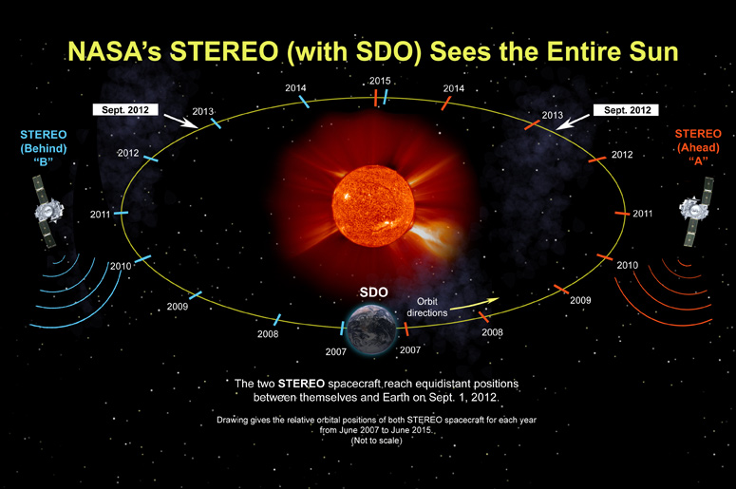
The STEREO Mission

Slide 3
STEREO Instruments
https://stereo.gsfc.nasa.gov/instruments/instruments.shtml
STEREO has 4 ”instruments”
  SECCHI – A suite of 4 imagers
  SWAVES – An electric fields/waves instrument
  IMPACT – A suite of 7 instruments
  PLASTIC – A solar wind ion instrument

Slide 4
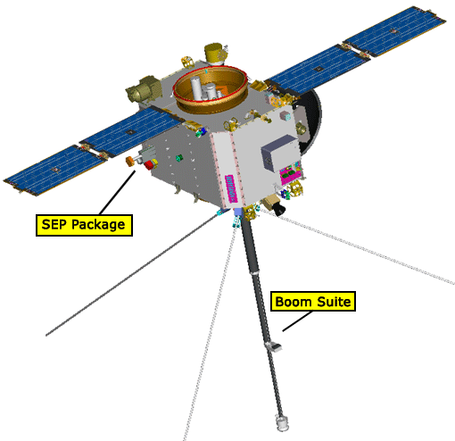
IMPACT

Slide 5
IMPACT’s Instruments
IMPACT’s 7 instruments are divided into 2 groups:
The Boom Suite
  MAG – Magnetometer
  SWEA – Solar Wind Electron Analyzer
  STE – Suprathermal Electron Telescope
The SEP Suite
  HET – High Energy Telescope
  LET – Low Energy Telescope
  SIT – Suprathermal Ion Telescope
  SEPT – Solar Electron Proton Telescope

Slide 6
A Couple of Things
We refer to IMPACT’s onboard computer at the IDPU
The IDPU runs the Boom Suite instruments and the PLASTIC instrument
The IDPU acts as a “bent pipe” for forwarding commands and telemetry to/from the SEP Suite (which has its own DPU)
While we don’t command the PLASTIC and SEP Suite directly from UCB, we must be aware that we can drastically affect these instruments often meaning collaborating between teams for things like instrument resets
Also when PLASTIC or SEP need to command we often need to be involved

Slide 7
Mission Operations Center
The STEREO Mission Operations Center is located at APL
When we command, we connect a computer (usually at UCB) to the MOC at APL. Our commands are forwarded by the MOC to the DSN for transmission to the spacecraft
If we are commanding in real-time, we typically call into the MOC’s “voiceloop” which allows us to speak with the MOC and any other instrument teams that may be online
IMPORTANT: Real-time commanding requires involvement by the MOC. Someone there has to open our command queue. This is not required for routine non-real-time commanding
If we do not command in real-time (which is usual for routine commanding), our commands go up during the following contact

Slide 8
What IMPACT Ops Does
Mostly what we do is monitor the IMPACT state of health. Basically we’re looking for red on the GSE display
Routine commanding includes:
  Clearing the error messages (once/month)
  Uploading new zeroes/offsets for MAG (once/month)
  Updating the RAM checksum after a SEU (0-several times/year)
Less routine commanding includes:
  Instrument reset recovery (maybe 1 every 5 years roughly)
  Troubleshooting/adjusting systems that misbehave (even more rare now)

Slide 9
The Other IMPACT POC
IMPACT actually has 2 POC’s. One is at UCB. The other is at APL.
The APL POC is often used by the SEP Suite folks, but it should be functionally identical to the one at UCB and is intended as a hot backup should the UCB POC go down
Kristen Wortman has been the person using and maintaining the APL POC. Her contact info is given in some documentation I have for you

Slide 10
Command Workflow – Connecting
If outside of SSL, connect to the SSL (or UCB) VPN
Use Microsoft Remote Desktop (or equivalent) to connect to the IMPACT GSE at impacta.ssl.Berkeley.edu (credentials I will give you)
If the GSE software is not already running, run “stgsect”. This should start the GSE interface.
If telemetry is not flowing, we’re either between contacts or the GSE telemetry has gotten hung up. In the latter case, simply toggle the “TLM” button so that it’s green. If we’re in a contact, you should start to see things changing in the interface.

Slide 11
Command Workflow Commanding
If you are doing real-time commanding, call into the APL voiceloop. Things I commonly ask the MOC on the loop: “When will my command queue be open?” Or if no telemetry is flowing, “is there a problem with the DSN?”
Open PuTTY and connect to the command server at APL. Then toggle the “CMD” button in the GSE. If all is right, this should now be green.
Command away

Slide 12
Special Note about Real-Time
Real-time commanding typically needs to be arranged with APL in advance either by phone or email. If it’s the middle of the night and you know what is hitting the fan, APL will send someone into the MOC to assist. However, if the situation is less dire, they will likely want us to command at a more convenient time. All depended on the urgency.
I generally reserve real-time commanding for anomalies (think instrument reset, PLASTIC high voltage problems) and for testing the interface

Slide 13
Working with the SEP Team
If the SEP team needs to command, they need to use either the UCB or APL POC to send their commands. They have their own SEP GSEs (one at Caltech, one at APL). Whichever SEP GSE they are using, they then need to connect to either the UCB or APL IMPACT GSE.
There are ports we need to open inside the IMPACT GSE to facilitate this is they are going through UCB. (If they are going through APL, Kristin usually comes in to support that). There are 2 ports for them: a telemetry forwarding port which sends them real-time telemetry, and a commanding port through which they send their commands)
The connection between, say, the Caltech SEP GSE and the UCB IMPACT GSE is tested regularly. It can get really buggy requiring reboots of either or both the UCB IMPACT GSE and/or the Caltech SEP GSE.

Slide 14
A Note on PLASTIC
PLASTIC’s flight software runs on our IDPU, and you will see a subset of PLASTIC housekeeping in our GSE interface
Especially in a situation in which PLASTIC is coming up from being shut off, there are commands we need to send when PLASTIC requests us to. Details on the IMPACT power cycle procedure are in a document I am giving you
It’s important to realize that if IMPACT gets powered down, PLASTIC does too. Sort of a package deal.

